Slide 1

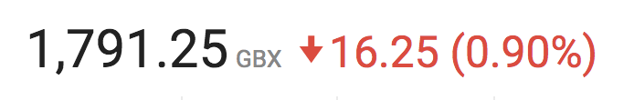

Slide 2

Company Profile
Produces business IT software for healthcare companies
Headquarters in Edinburgh, Scotland, UK
American Headquarters in Atlanta, Georgia
Founded in May 1999 by CEO Keith Neilson and Gordon Craig
250+ Employees
Publicly Traded

Slide 3
Products

Slide 4
Patient Charge Estimator®
Help estimate the cost to a patient for a procedure
Allows for more consistent cost estimates across departments
Takes into account many factors to gain more accurate picture of cost

Slide 5
Pharmacy ChargeLink®
Tracks medications and drugs being used in the hospital
Detects when a medication has not been accurately recorded
Allows for accurate reimbursements from healthcare companies or medicare
Collects data for future analysis of spending and prescription needs

Slide 6
InSight Audit®
Reduces paper uses and moves most forms online
Centralizes audit information on one platform for company wide consistency
Automates data entry

Slide 7
Chargemaster Toolkit
Serves as the initial listing of items billable to a hospital patient or insurance provider. Prices tend to be inflated & process is error prone
Solutions that help optimize reimbursement, compliance, and pricing
Increases operational efficiency by automating chargemaster management
Ranked 1 by KLAS in Revenue Cycle

Slide 8
How Data Was Obtained
MIMIC-II
Multiparameter Intelligent Monitoring in Intensive Care
Developed by MIT
Comprehensive clinical data from tens of thousands of Intensive Care Unit (ICU) patients
demographics, vital signs, laboratory tests, medications, and more
Given in .txt files, needed to convert to one .csv file
data.medicare.gov
Hospital Readmissions Reduction Program
For Excess readmissions
Ratio greater than 1.0000 indicates excess readmissions

Slide 9
Our Data
For medicare data
Given in .csv organized by state
Took averages of all three ratios; Excess Readmission Ratio, Predicted Readmission Rate, Expected Readmission Rate
For MIMIC-II
Created Python code to read-in .txt file into a .csv file
Basic Patient demographics, admittance date, reason for admittance, medical events, drugs/treatment given, and comorbidity indicators

Slide 10
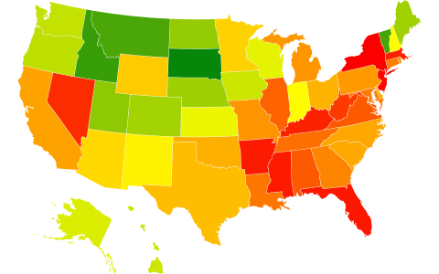
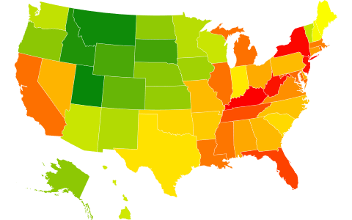
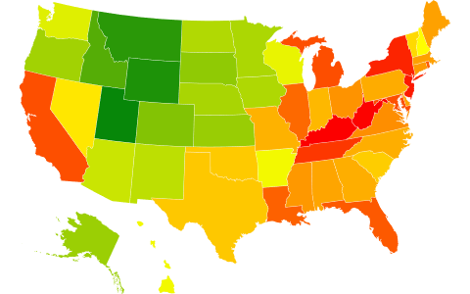
Heat Maps
Average Excess Readmission Ratio
Average Predicted Readmission Rate
Average Expected Readmission Rate
Data from data.medicare.gov

Slide 11
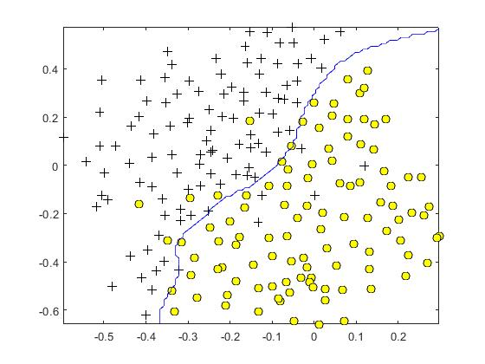
Support Vector Machine
Nonlinear line of best fit between two different classifiers
In our case, vectorize our data given
Classifiers; Not expected to be readmitted and expected to be readmitted

